Slide 1

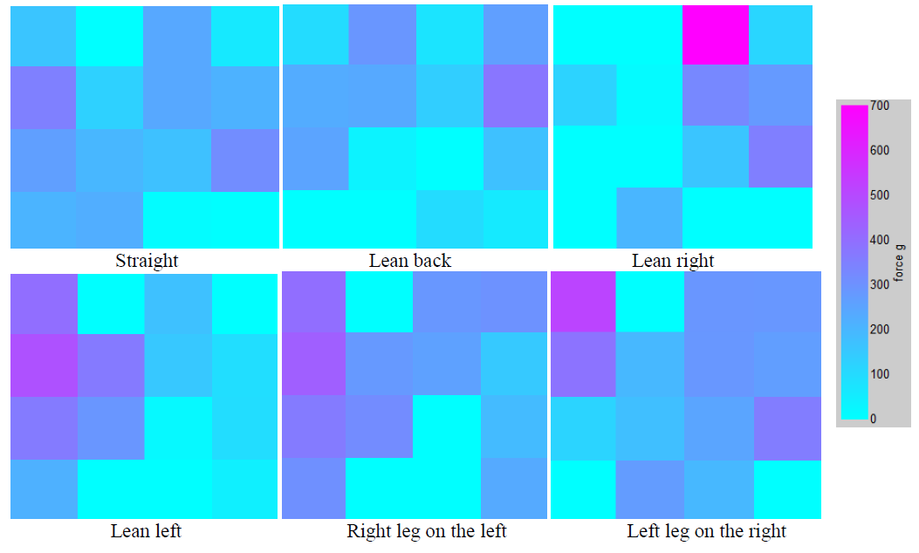
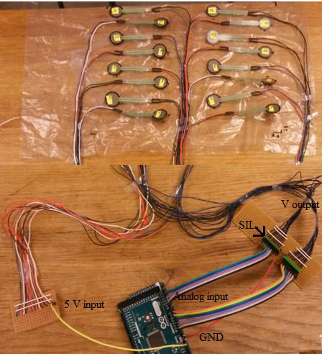

Research of human ergonomic pressure adjustment to the sitting surface
Ieva Miagkovaite¹, Vytautas Bucinskas¹, Inga Morkvenaite-Vilkonciene^{1,2}
¹ Vilnius Gediminas Technical University, Faculty of Mechanics, Vilnius, Lithuania
² Center for Physical Sciences and Technology, Vilnius, Lithuania
E-mail: ieva.miagkovaite@stud.vgtu.lt
Introduction
Analysis of human fatigue in a seated working place based on pressure measurements is not widely investigated. Most papers of pressure measurements [1] made to prevent development of pressure ulcers for disable people in wheelchairs [2]. The motivation for this topic comes from fatigue behavior of human tests and ergonomics of seated working places. Sitting in uncomfortable chair requires greater muscular force and control to maintain stability and equilibrium, which leads to fatigue and discomfort [3].
Methods
Pressure sensing is done with Interlink Electronics force sensing resistors (FSR-part no. 402), which increase the resistance with increasing force applied on the sensing area. Sensor connected with resistor of known value creates voltage divider, where drop of input voltage corresponds to weight applied on the sensor. The matrix of sensors (4x4) was used for measurements. The measuring matrix is fixed with sensing area 24x22 cm. Sensor wires connected on PCB boards, resistors with fixed value of 3.3 kΩ single-in-line (SIL), for voltage supply and output measurements the Arduino MEGA 2560 microcontroller were used (Fig. 1). The program of measurement reading and visualization is created in Matlab package Simulink. Values of sensors are visualized as color matrix corresponding to sensor placement.
Another test was made by placing sensor mat 3 cm from chair front edge and 20 cm from backrest, obtained data did not reflect highest pressure points, but clearly visualized leg crossing positions. Results show, having small amount of sensors can represent critical data of most pressure places.
Having more sensors that can cover all sitting surface can represent data of leg position more detailed. Furthermore, small spacing between sensors can result in very low readings of particular places where is low pressure. Spacing of the sensors also depends on tested body anatomy for important data reflection.
Fig. 2. Measuring mat and sensor connections
Discussion
Measured value can change from 20 g to 60 g depending on the sitting surface (hard or soft), because of this variation precise tests has to be performed on different surfaces. For this reason mat can be used for comparison of pressure of different parts, but not precise measurements of the weight.
Humans of different body physique should be tested to find optimal spacing of the sensors.
Fig. 1. Measuring mat and sensor connections
References
Results
Obtained results (Fig. 2) were corresponding to change of the position of analyzed person. Sensor mat was placed 8 cm from chair backrest and 16 cm front edge. Highest pressure points were under the sit bones (ischial tuberosity).
[1] Jawad, A.; Andersson, H.; Sidén, J. 2017. Sitting posture recognition using screen printed large area pressure sensors, IEEE Sensors.
[2] Jun, Y.; Cho. E.; Park, S. H. 2016. Body pressure distribution measurement for comfort evaluation of a coccyx seating mat, 3r
d International Mega - Conference on Green and Smart Technology.
[3] Anderson, S., et al. 2013. Correlating air cushion pressure to maximum interface pressure on the buttocks, Resna annual conference

