Slide 1
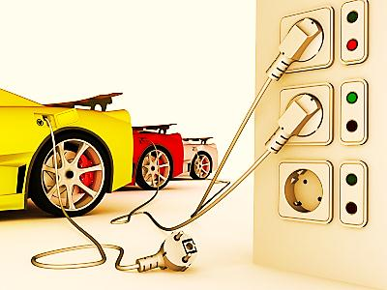

ELECTRIC CAR INTEGRATION
IN VILNIUS
Gintare Zorskaite¹, Vita Duminyte², Grazvydas-Mykolas Paliulis³
Vilnius Gediminas technical university, Saulėtekio ave. 11, LT-10223, Vilnius, Lithuania.
E-mails: ¹gintare.zorskaite@vgtu.lt; ²vitad@vgtu.lt; ³msk@vgtu.lt
Gintarė Zorskaitė,
Vita Dūminytė,
doc.dr. Gražvydas Mykolas Paliulis 2011 m.

Slide 2
Lithuania, as the EU Member State, contributes to the long-term sustainable development strategy aimed at preservation of clean and healthy environment and higher quality of life for the present and future generations.
Gintarė Zorskaitė,
Vita Dūminytė,
doc.dr. Gražvydas Mykolas Paliulis 2011 m.

Slide 3
The main sources of environmental pollution is an increasing number of vehicles in towns. Since 2000, transport sector emissions and their share in the total amount of emissions have been annually increasing.
Table 1. Population and car ownership level in Vilnius, thous.(Statistic department, 2009)
Year | 1980 | 2004 | 2005 | 2007 | 2008 | 2009
Population | 492.0 | 552.9 | 553.6 | 554.4 | 555.7 | 558.2
Car ownership level | 71 | 450 | 487 | 545 | 583 | 576
Gintarė Zorskaitė,
Vita Dūminytė,
doc.dr. Gražvydas Mykolas Paliulis 2011 m.

Slide 4
Transport mode depends on distance.
Short distanced up to 1-2 km are usually travelled on foot, while longer distances need vehicles, namely bicycles, motorcycles, public transport or private cars. In towns 30% of trips by car are up to 3 km long, and 50% of trips by car are up to 5 km long.
Gintarė Zorskaitė,
Vita Dūminytė,
doc.dr. Gražvydas Mykolas Paliulis 2011 m.

Slide 5
With rapid sprawl of towns people will not refuse their cars and will not start cycling. This will result in further environmental pollution and wasteful use of limited oil resources. The present situation would improve if electric cars appear in streets. It is important to analyse and substantiate the optimal deployment of plug-in stations in accordance with the chosen criteria, the related problems and possibilities.
The electric car plug-in system is not yet available in Lithuania or in other Baltic States.
Gintarė Zorskaitė,
Vita Dūminytė,
doc.dr. Gražvydas Mykolas Paliulis 2011 m.

Slide 6
What main problems should be solved to create environment for the use of electric cars in Lithuania?
Private cooperation between capital and town municipalities in development of the plug-in infrastructure;
Development of standard technical requirements;
Parking places for electric cars with plug-in devices;
A considerable amount of energy developing the network of speedy plug-in stations;
System of payment for electricity.
Gintarė Zorskaitė,
Vita Dūminytė,
doc.dr. Gražvydas Mykolas Paliulis 2011 m.

Slide 7
Vision of the Ministry of Transport and Communications of Lithuania :
2015 - a pilot electric car battery plug-in and switch infrastructure network will be developed;
2020 - an electric car plant will be built in Lithuania;
2030 - the public transport of the largest towns of Lithuania will be electricity-powered, and that green cars will account for up to 40% of all cars.
Is it possible?
In Lithuania electric cars have good prospects. Lithuania has good conditions for testing electric cars due to favourable climate and suitable distances.
Gintarė Zorskaitė,
Vita Dūminytė,
doc.dr. Gražvydas Mykolas Paliulis 2011 m.

Slide 8
How to motivate Lithuania’s citizens to choose electric cars?
free entrance into the pay zones;
free parking for electris cars in the downtown area of the town;
partial compensation for battery charging;
free registration of a car, no road charges.
Gintarė Zorskaitė,
Vita Dūminytė,
doc.dr. Gražvydas Mykolas Paliulis 2011 m.

Slide 9
The town of Vilnius has been chosen for integration of electric cars in Lithuania. The town was analysed with the following regard:
population density in residential areas;
the number of jobs in the districts of the town;
distribution of the large daily transport flows on the street network of the town.
Gintarė Zorskaitė,
Vita Dūminytė,
doc.dr. Gražvydas Mykolas Paliulis 2011 m.

Slide 10
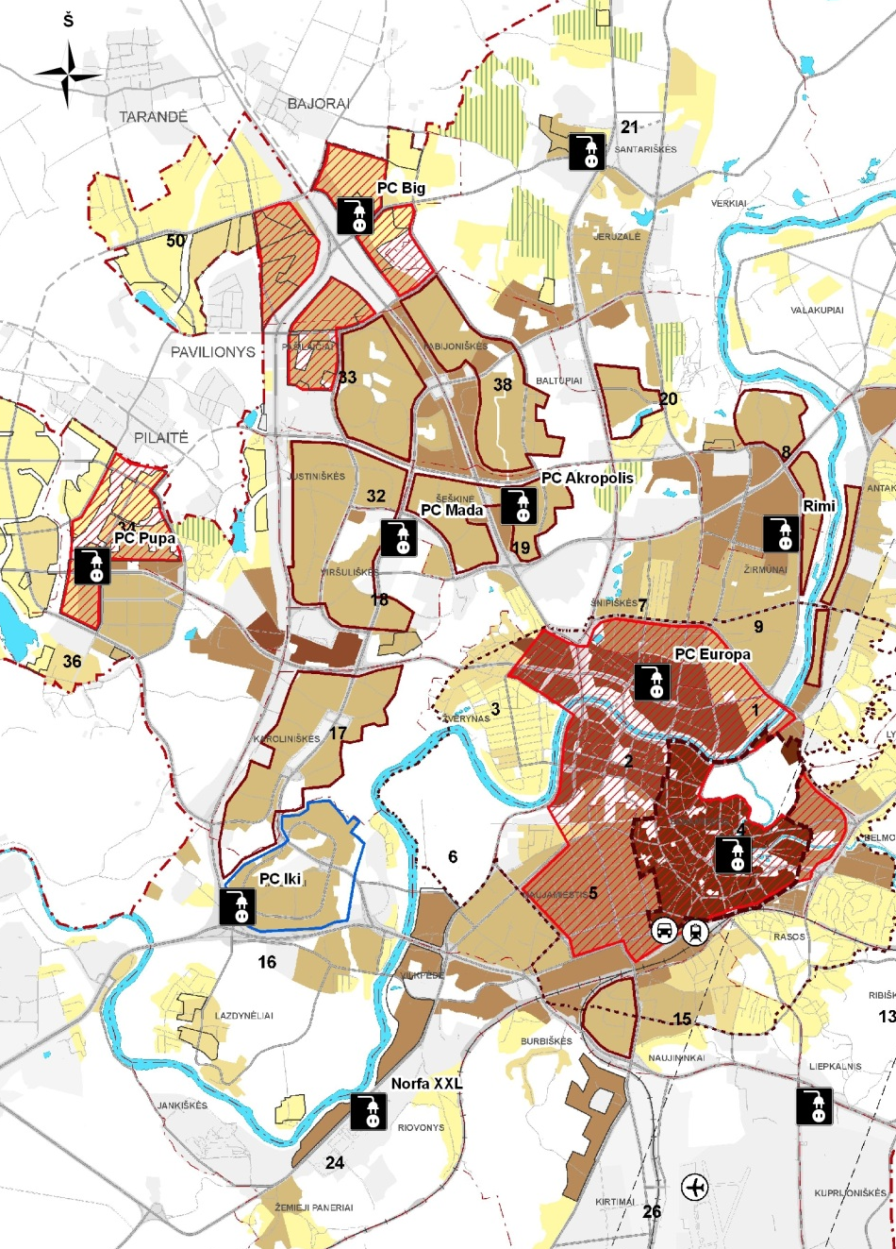
Concept 1. Population density in residential areas.
Gintarė Zorskaitė,
Vita Dūminytė,
doc.dr. Gražvydas Mykolas Paliulis 2011 m.

Slide 11
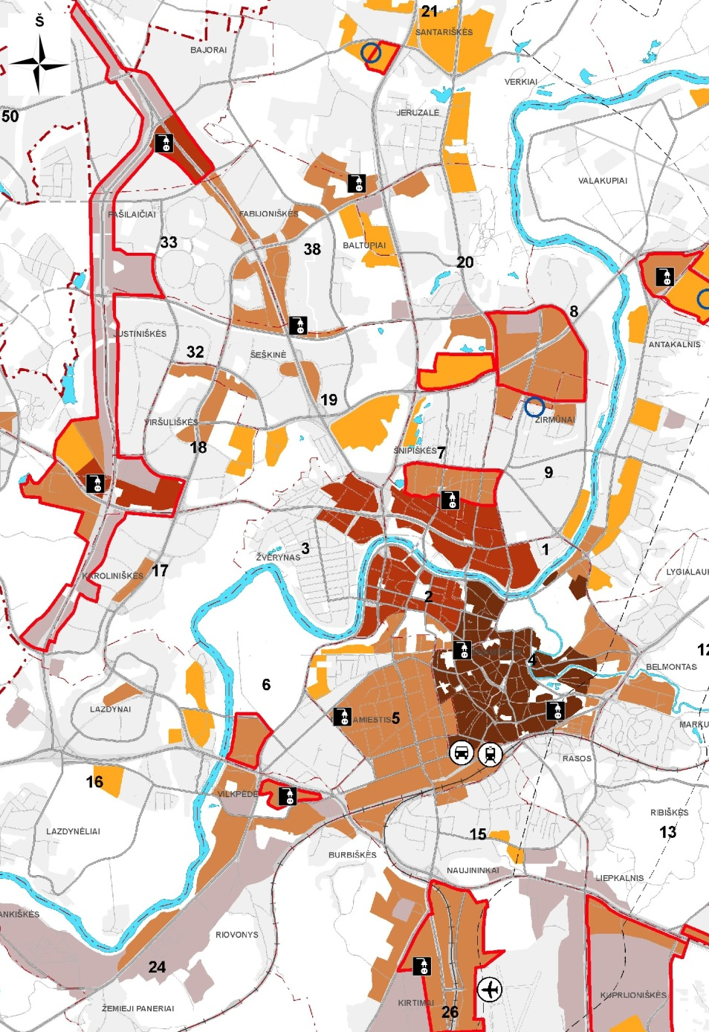
Concept 2. The number of jobs in the districts of the town.
Gintarė Zorskaitė,
Vita Dūminytė,
doc.dr. Gražvydas Mykolas Paliulis 2011 m.

Slide 12
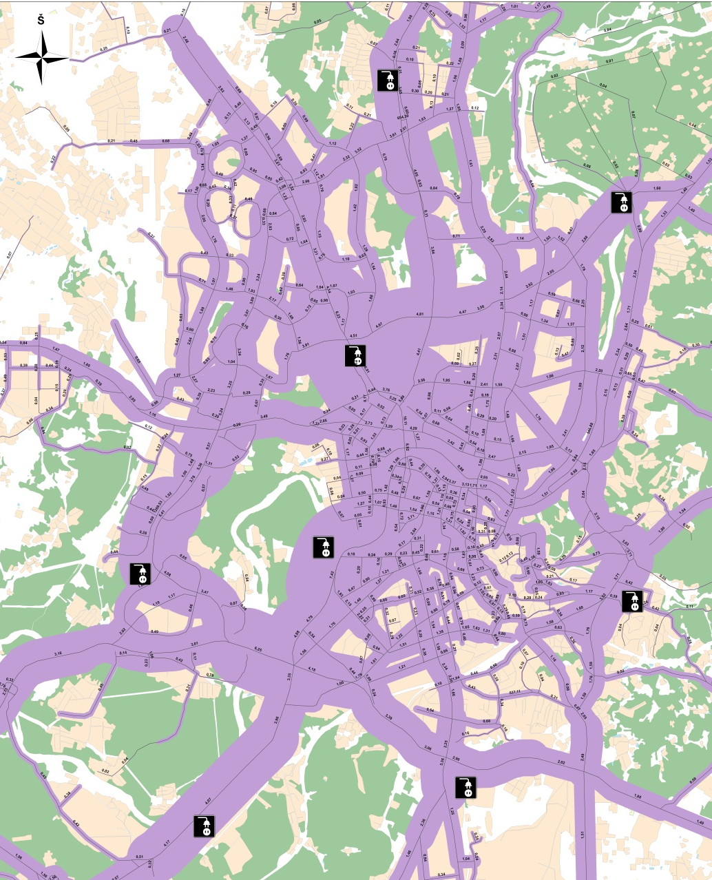
Concept 3. Distribution of the large daily transport flows on the street network of the town.
Gintarė Zorskaitė,
Vita Dūminytė,
doc.dr. Gražvydas Mykolas Paliulis 2011 m.

Slide 13
In 2020 electric cars will account for 10% of the EU fleet, this is an optimistic tendency of Lithuania and it would be a really if 21.000 electric cars are register every year.
Fig 6. Tendency of the number of electric cars in Lithuania in 2020.
Gintarė Zorskaitė,
Vita Dūminytė,
doc.dr. Gražvydas Mykolas Paliulis 2011 m.

Slide 14
SWOT analysis
Strengths
+ Electric cars are noiseless + They are environment friendly, generate no emissions + Run of an electric car is sufficient for trips within the town as trips of 80% of European citizens do not exceed 60 km per day + A car could be charged while driving + Small electric cars raise less problems related to street capacity and parking + Electric car maintenance costs are 20% lower, while service costs are 50% lower compared to internal-combustion cars
Opportunities
- Strict EU environmental requirements encourage use of electric cars - No impact is caused by fuel price rise as electric cars use electricity that could be generated from renewable sources and nuclear fuel - New technologies allow manufacturing and use of new generation cars - Priority for those who drive and park in the downtown and old town area of the town
Gintarė Zorskaitė,
Vita Dūminytė,
doc.dr. Gražvydas Mykolas Paliulis 2011 m.

Slide 15
SWOT analysis
Weaknesses
+ Large investment into plug-in network installation + New batteries are expensive (10,000-12,000 USD) + Dependence on the development of plug-in network in the town + Run after a single charge is up to 150 km, a car is not good for long inter-town trips + In the temperature of -20⁰C the battery capacity becomes 50% lower + Price of an electric car is 30-40% higher that of an internal-combustion car + A car itself and its luggage compartment are small + Batteries serve 10 years or 200,000 km
Threats
- New technologies are necessary for manufacture and use of electric cars - Electric cars are very silent so this may result in incidents that involve pedestrians - Run after single charging reduces with a car getting older - Charging voltage above 24V is dangerous for those who are around - Dependence on foreign energy source suppliers (in Lithuania power-stations use gas or fuel oil) - Amendment of legislation
Gintarė Zorskaitė,
Vita Dūminytė,
doc.dr. Gražvydas Mykolas Paliulis 2011 m.

Slide 16
Conclusions
1. Electric car plug-in stations and their number in Vilnius would depend on population density in residential areas, on jobs in downtown and surrounding areas as well as close to busy high-speed streets.
2. According to research, 80% of trips made by citizens of the town amount to 60 km, so single charge run of 150 km would be fully sufficient to satisfy the needs of citizens of the towns of Lithuania.
3. There actions should be performed in the towns of Lithuania in order to stimulate use of electric cars, namely: political environment should encourage acquisition of electric cars, plug-in infrastructure should be installed, standards imposed on electric cars and infrastructure should be developed and such standards should encourage sticking to the EU requirements.
4. In the EU market electric cars should account for 3-10% of total cars by 2020. According to the data of motor-businessmen association, after 2015 citizens of Lithuania could annually acquire 6000-21,000 electric cars.
Gintarė Zorskaitė,
Vita Dūminytė,
doc.dr. Gražvydas Mykolas Paliulis 2011 m.

Slide 17
Thank you for your attention !
Contact:
Gintarė Zorskaitė
gintare.zorskaite@vgtu.lt
Gintarė Zorskaitė,
Vita Dūminytė,
doc.dr. Gražvydas Mykolas Paliulis 2011 m.

